Slide 1
VIDEO GAME SALES ANALYSIS
Done By:
Yashwanth K
Nov DA & DS

Slide 2
PROJECT DESCRIPTON
Objective:
The goal of this project is to analyze global video game sales data
To gain insights into sales performance across different platforms, genres, and regions.
The analysis helps identify sales trends, top-performing games, and the market's overall distribution across various categories.

Slide 3
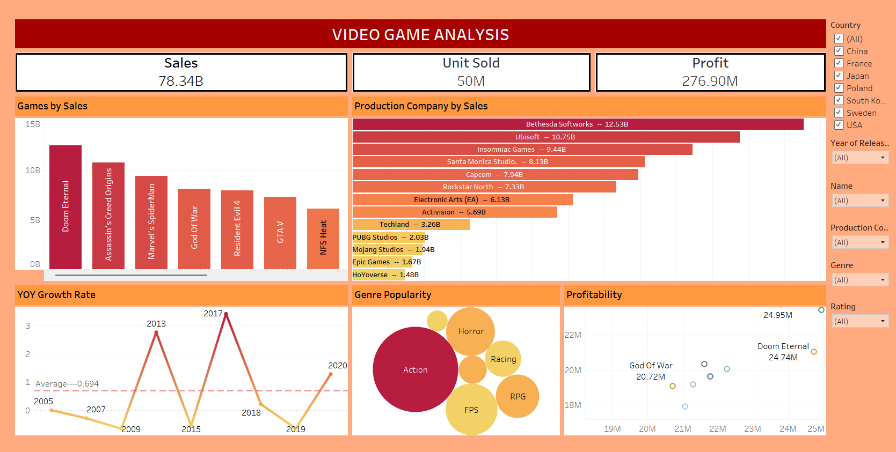
DASHBOARD

Slide 4
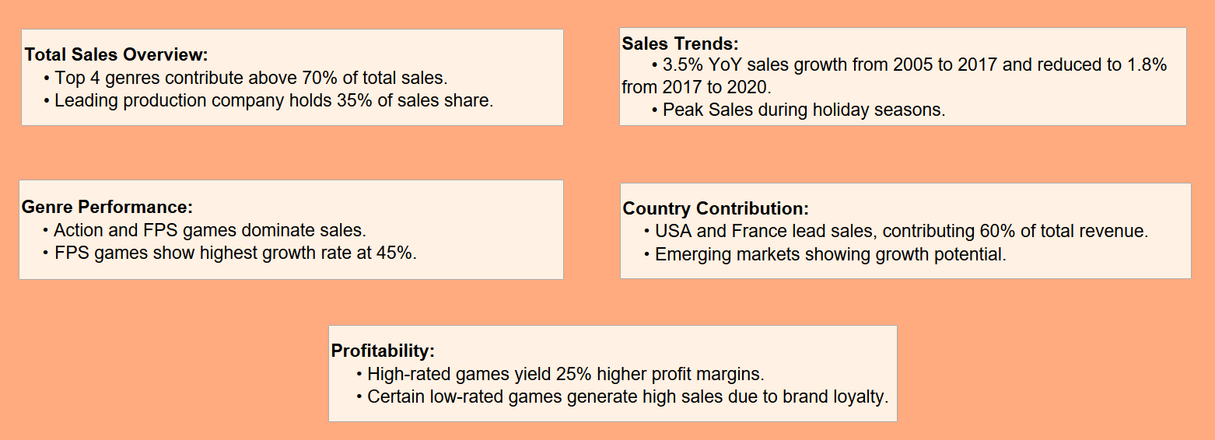
INSIGHTS

Slide 5
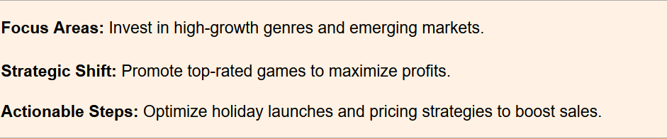
CONCLUSION

Slide 6


